Slide 1

OVF – Pester for SysAdmins
Irwin Strachan
@irwinstrachan

Slide 2

About_Irwin
Blogging
Pshirwin.wordpress.com
Slack
GitHub
Contributor powershell.com
@irwinstrachan

Slide 3
Agenda
Why OVF and what are the benefits
Basic concepts of OVF
Writing OVF Test
OVF Gotcha’s
Demos
Comments

Slide 4
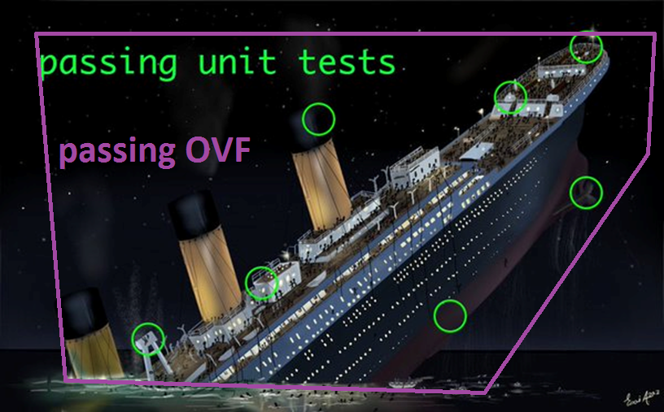
Why OVF – What are the benefits?

Slide 5
Writing OVF Tests
Create Snapshots
If possible use source used to automate the process
Verify operational functionality
Rectify any discrepancies

Slide 6
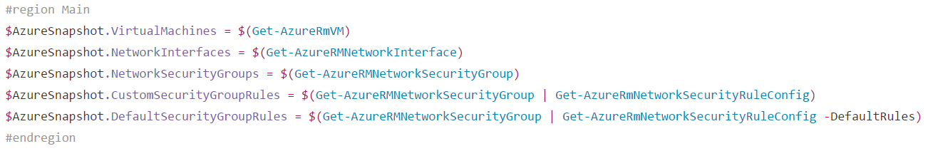
Why snapshots
Captures a specific state in point of time
Accumilates a history of Information
Gateway to other processes
Example

Slide 7
Demo Time
AD OVF
AD snapshot
AD Operation readiness
GPO OVF
GPO Link orders
DFSn OVF
DFS snapshot
DFS Link & Targets

Slide 8
OVF Gotchas
Understand the difference between simplistic & deterministic tests
Set enumeration matters. You decide what’s valid.
Don’t just really on simplistic test
Never trust a test that doesn’t fail!

Slide 9
Operational Testing
Test your infrastructure
Verify changes in infrastructure
Useful in the following scenarios:
Migrations
New deployments
When incidents occur
Automatically verify critical systems

Slide 10
Interesting reading material
A different pitch for Pester
Writing Pester Tests - PowerShell team
Sapien Pester Blogs

Slide 11
Take away
Pester is also for SysAdmins not just Developers
OVF is more the mindset of SySAdmins
Never trust a Test that doesn’t fail
OVF is about testing what’s critical or mandatory
Pester ship by default with Win2k16 (That should tell you something)
Have fun Learning Pester!

Slide 12
Questions?

